Slide 1
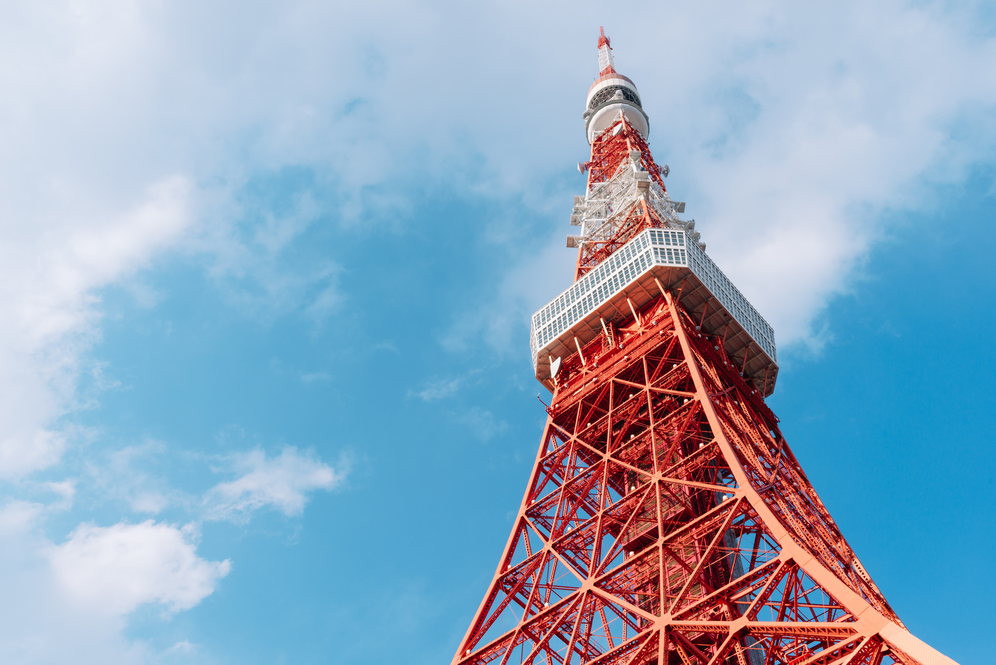

My Travel Plan
2025 SEPT
5 DAYS 4 NIGHTS
Check Details

Slide 2
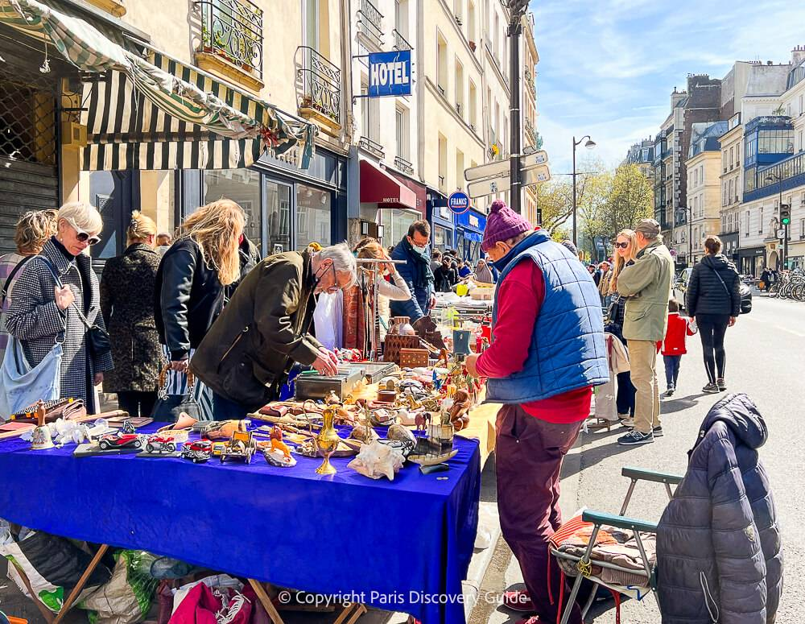
Table of Contents
Trip Overview
3
Arrival & Departure
4
Accommodation
5
Food Experience List
6
Budget
7

Slide 3
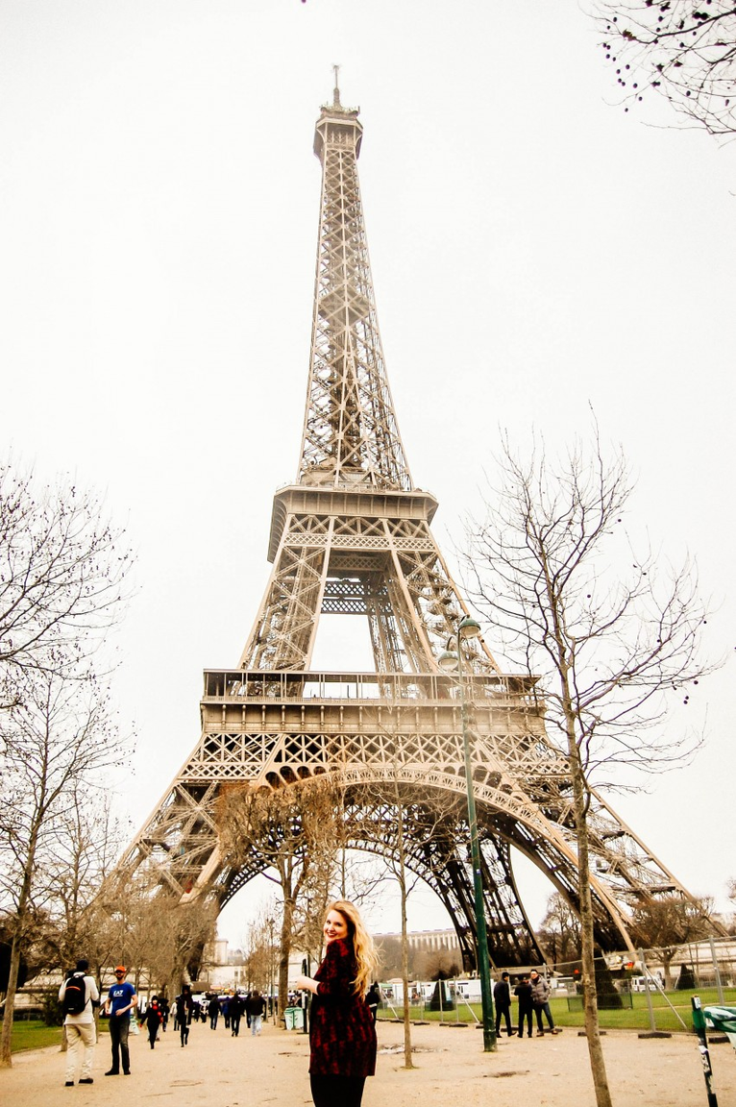
Trip Overview
Mode
Type
Train & foot
Semi-budget, solo or duo trip
Duration
Major Focus
5 Days /
4 Nights
Local Culture, Light Adventure, Food &
Eiffel Tower exploration
3

Slide 4
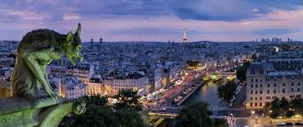
Arrival & Departure
FRANCE TO PARIS
PARIS TO FRANCE
Departure
Arrival
Departure
Arrival
08:15 AM
04:10 PM
06:45 PM
12:15 AM (+1)
Meals
Free
Luggage
30 kg
4

Slide 5
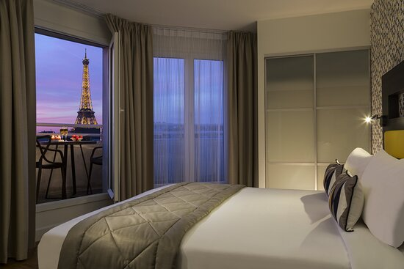
Accommodation
4 NIGHTS AT GUESTHOUSE
Clean + cozy
Shared kitchen, optional private room
Laundry access
Local area walkable
Beautiful view...
Address
The Champs Elsees...
5

Slide 6



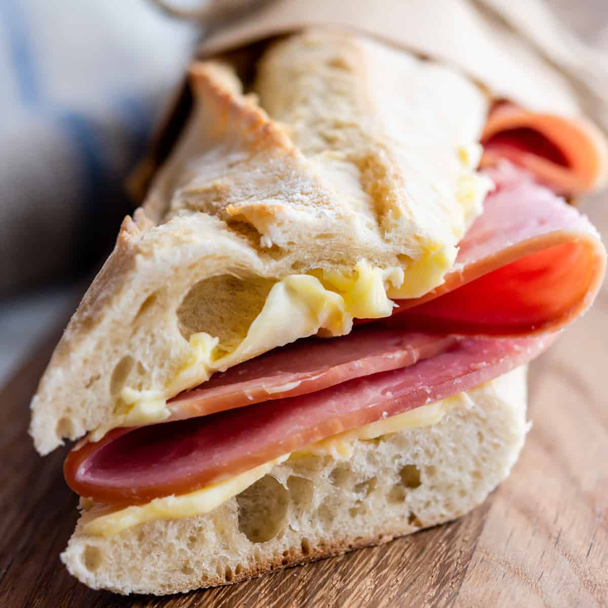

Food Experience List
Croissants
Macarons
French Onion Soup
Jambon Burre
6

Slide 7
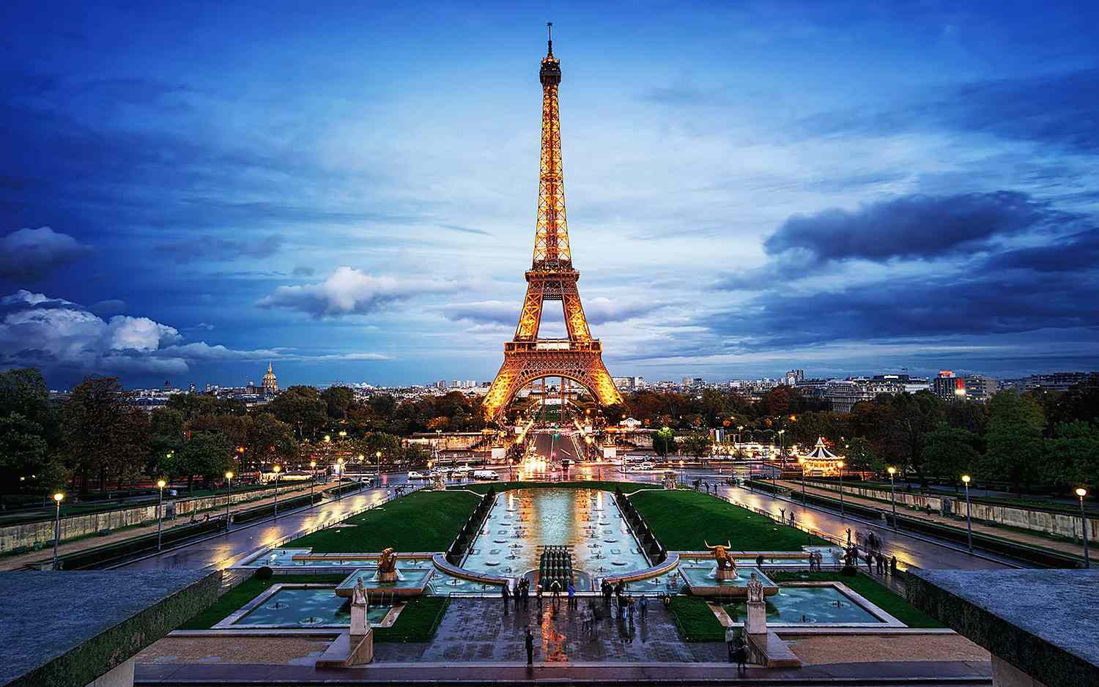
Budget
Category | Cost
Flights | $300
Accommodation | $180
Food | $100
Transport | $60
Tickets/Entry | $40
Paris exploration | $70
Total | $750
9

Slide 8
The End
SEE YOU AT NEXT TRIP!
@reallygreatsite

